Slide 1

Problems on Conditional Probability 2003

Slide 2
Reference
Data
Youtube
Code

Slide 3
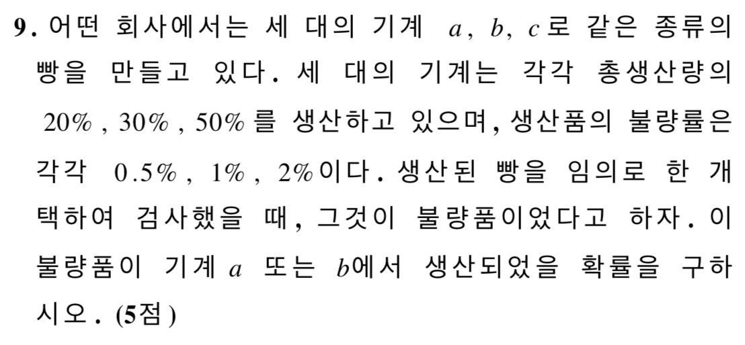
[2003]

Slide 4
